Slide 1
Lecture: 16
Passing Arrays to Function
Insertion and Deletion with Arrays

Slide 2
Arrays can be passed to functions in two ways:
Pass entire array
Pass array element by element

Slide 3
Pass entire array
Here entire array can be passed as an argument to the function
Function gets complete access to the original array
While passing entire array Address of first element is passed to function, any changes made inside function, directly affects the Original value.
void modifyArray(int b[], int arraySize);
Function passing method: “ Pass by Address”

Slide 4
Passing array element by element
Here individual elements are passed to the function as argument
Duplicate carbon copy of Original variable is passed to function
So any changes made inside function does not affects the original value
Function doesn’t get complete access to the original array element.
void modifyElement(int e);
Function passing method: “ Pass by Value”

Slide 5
Passing Arrays to Functions
Function prototype
void modifyArray(int b[], int arraySize);
Parameter names optional in prototype
int b[] could be written int []
int arraySize could be simply int
void modifyArray(int [], int);
Function call
int a[SIZE];
modifyArray(a, SIZE);

Slide 6
Program example-1 Passing Array to a function using by reference(or Passing entire array at once)
#include<stdio.h>
void reference(int[],int);
int main()
{
int arr[100],n;
int i;
printf("\n Enter n:");
scanf("%d",&n);
printf("\n Enter array elements:");
for(i=0;i<n;i++)
{
scanf("%d",&arr[i]);
}
printf("\n Elements by reference:");
reference(arr,n);//Passing array by call by reference
return 0;
}
void reference(int x[],int size)
{
int i;
for(i=0;i<size;i++)
{
printf("%d ",x[i]);
}
}

Slide 7
Program example-2 Passing Array to a function using by value(or Passing element by element)
#include<stdio.h>
void value(int);
int main()
{
int arr[100],n;
int i;
printf("\n Enter n:");
scanf("%d",&n);
printf("\n Enter array elements:");
for(i=0;i<n;i++)
{
scanf("%d",&arr[i]);
}
printf("\n Passing elements by value:");
for(i=0;i<5;i++)
{
value(arr[i]);//Passing array value by Call by value
}
return 0;
}
void value(int u)
{
printf("%d ",u);
}

Slide 8
Application Of Array :
Stores Elements of Same Data Type
Array is used to store the number of elements that are of same data type.
Eg: int students[30];
array of marks of five subjects for single student.
float marks[5];
array of marks of five subjects for 30 students.
float marks[30][5]
Similarly if we declare the character array then it can hold only character.
So in short character array can store character variables while floating array stores only floating numbers.

Slide 9
Array Used for Maintaining multiple variable names using single name
Suppose we need to store 5 roll numbers of students then without declaration of array we need to declare following -
int roll1,roll2,roll3,roll4,roll5;
Now in order to get roll number of first student we need to access roll1.
Guess if we need to store roll numbers of 100 students then what will be the procedure.
Maintaining all the variables and remembering all these things is very difficult.
So we are using array which can store multiple values and we have to remember just single variable name.

Slide 10
Operations on arrays
Insertion of element into an array
Deletion of element from an array

Slide 11
Write a program to insert an element at a given position in 1D array
#include <stdio.h>
int main()
{
int array[100], position, c, n, value;
printf("Enter number of elements in array:\n");
scanf("%d", &n);
printf("Enter %d elements:\n", n);
for (c = 0; c < n; c++)
{
scanf("%d", &array[c]);
}
printf("Enter the location where you wish to insert an element:\n");
scanf("%d", &position);
printf("Enter the value to insert:\n");
scanf("%d", &value);
for (c = n - 1; c >= position - 1; c--)
{
array[c+1] = array[c];
}
array[position-1] = value;
printf("Resultant array is:\n");
for (c = 0; c <= n; c++)
{
printf("%d\n", array[c]);
}
return 0;
}

Slide 12
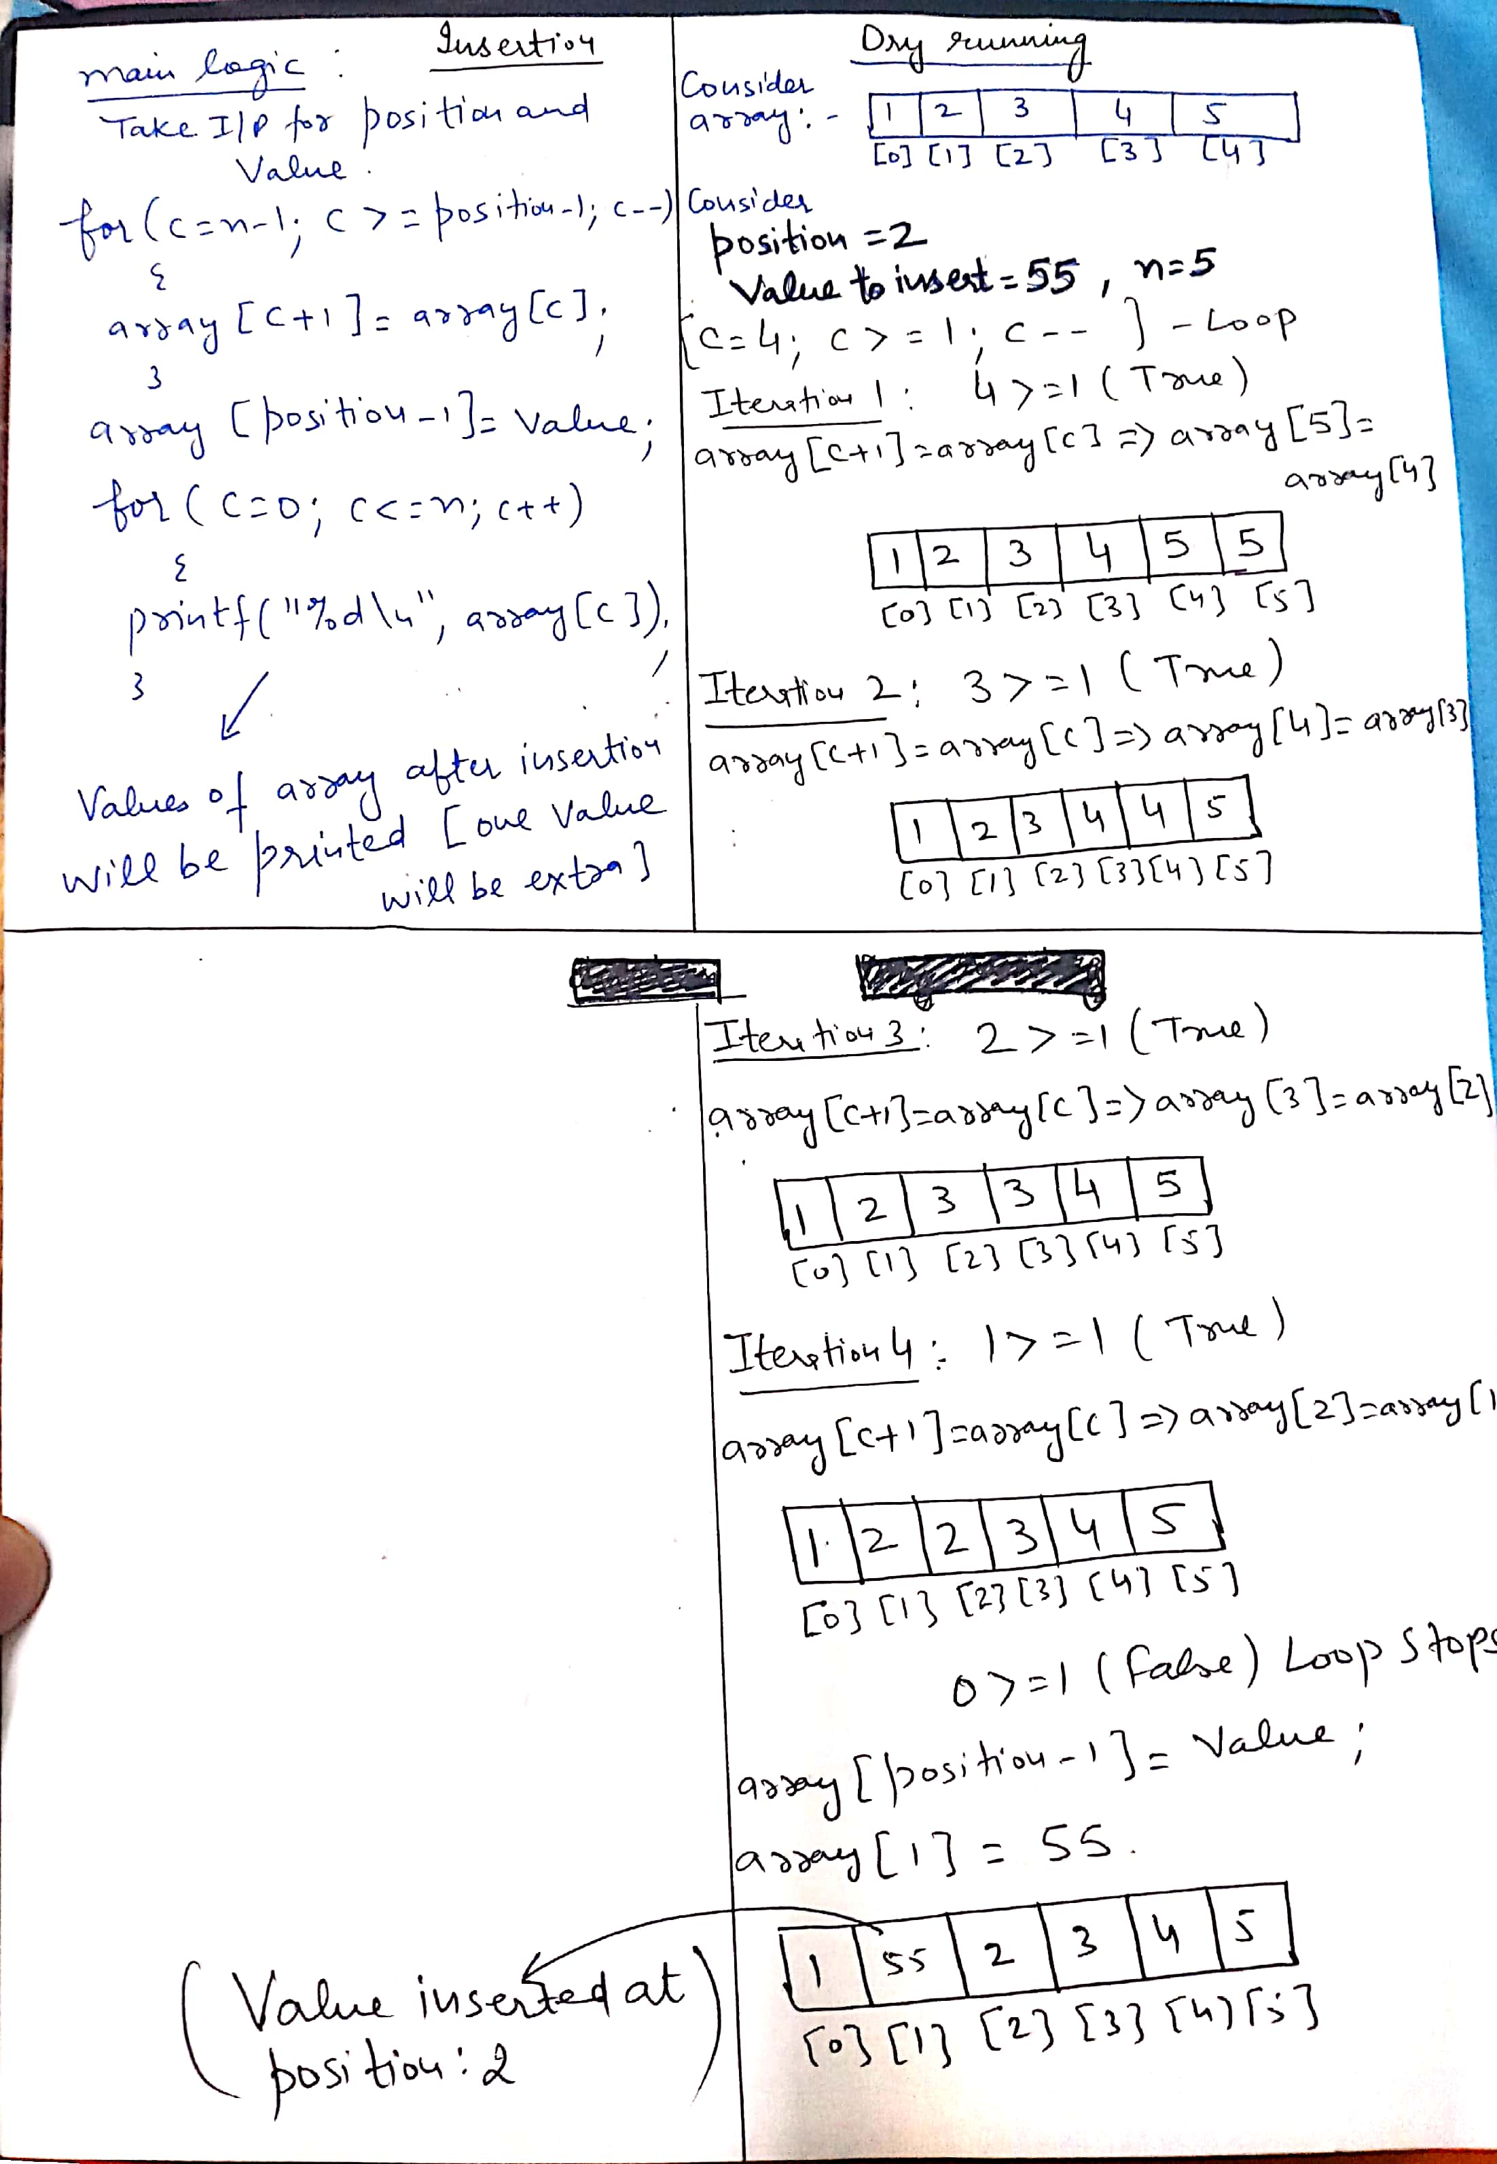
Dry running

Slide 13
Write a program delete an element from a given position in 1D array
#include <stdio.h>
int main()
{
int array[100], position, c, n;
printf("Enter number of elements in array\n");
scanf("%d", &n);
printf("Enter %d elements\n", n);
for (c = 0; c < n; c++)
{
scanf("%d", &array[c]);
}
printf("Enter the location where you wish to delete from an array\n");
scanf("%d", &position);
for (c = position-1; c < n-1; c++)
{
array[c] = array[c+1];
}
printf("Resultant array is\n");
for (c = 0; c < n-1; c++)
{
printf("%d\n", array[c]);
}
}

Slide 14
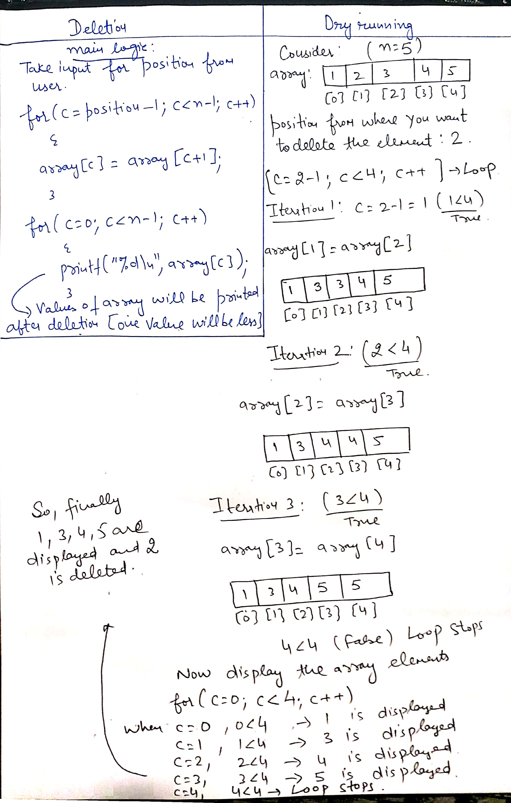
Dry running

Slide 15
Q1
#include <stdio.h>
void f(int a[])
{
a[1] = 3;
int i = 0;
for (i = 0;i < 3; i++)
printf("%d ", a[i]);
}
void main()
{
int a[3] = {0,0,0};
f(a);
}
0 3 0
3 3 3
3 0 0
0 0 0

Slide 16
Q2
#include <stdio.h>
void print(int []);
int main()
{
int ar[] = {10,20,30};
print(ar);
}
void print(int p[])
{
for(int i=0; i<2; i++)
printf("%d ", p[i]);
}
10 20
20 30
10 20 30
10 10 10

Slide 17
Q3
#include <stdio.h>
void print(int*);
int main()
{
int ar[] = {10,20,30};
print(ar+1);
}
void print(int *p)
{
printf("%d ", *p);
}
10
20
30
Garbage value

Slide 18
Q4
Let x be an array. Which of the following are illegal
A. x++
B. x+1
C. x*2
D. none of these

